Slide 1
KAILASH PARVAT FOODS
Truly healthy, Truly tasty!

Slide 2
About US
We manufacture 100% natural millet cookies with more than 111 variants of cookies and herbal beverages.
We are the leading PRIVATE LABELLER.
We are looking to bring Healthy Millet cookies into the International market. Some of our USPs when compared with other millet cookies in the market can be found in the profile.
We are also proud to say there are no other cookies formulations similar to ours currently in market.

Slide 3
Healthy COOKIES with 100% Natural Ingredients
Our Cookie USPs :
1.Millet Cookies ( Finger Millet, Pearl Millet, Ban yard Millet, Little Millet, Foxtail Millet, Sorghum etc.)
No Artificial Flavours/ Colour/ preservatives *
No Maida / Cholesterol/ Trans Fat
Yes to Whole grain, Organic Sugar, Healthy unique additions like herbs, vitamin fortified.
*INDIA’s ONLY MILLET COOKIES with NO ARTIFICIAL ANYTHNG.
2. Millet Raw Vegan Snacks (Sorghum, palm sugar)

Slide 4
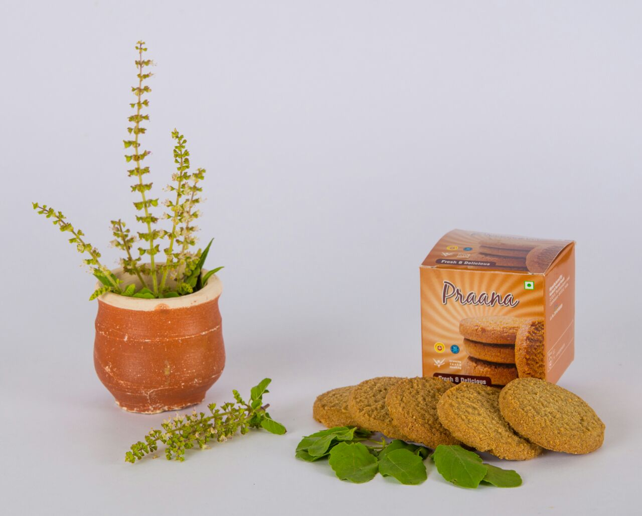
Tulsi Cookies

Slide 5
Vision
To Provide Truly Healthy, Truly Tasty, Truly Nutritious and Quality food product to the world.
To become the Leader in Healthy Millet food products in India and Internationally.
Mission

Slide 6
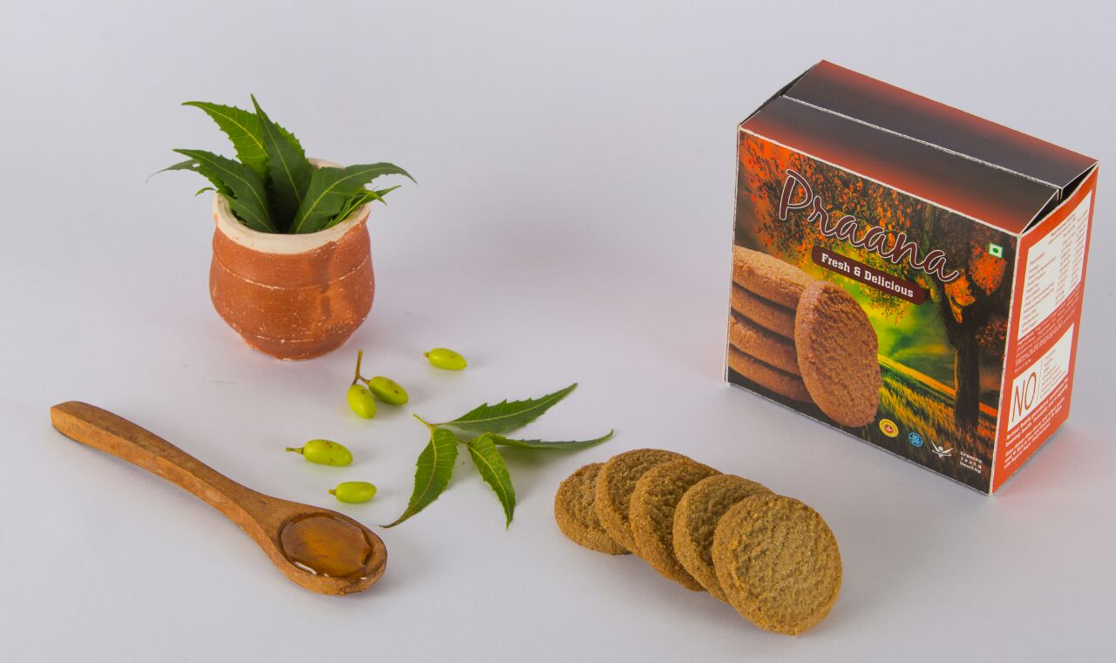
Neem Honey Cookies

Slide 7
Our cookies has the uniqueness of having a taste and health profile which is Unmatched 100% by other market cookies.
Some market other brands cookies if they are healthy e.g. they claim made from Ragi on one hand - then other ingredients will have artificial colours or preservatives or artificial sugar.
Some other cookies if 80 % healthy profile it matches like ours below - they do not make it taste good so difficult for people to eat them regularly.
However below ours is truly health and truly tasty and we know it from our clients feedback

Slide 8
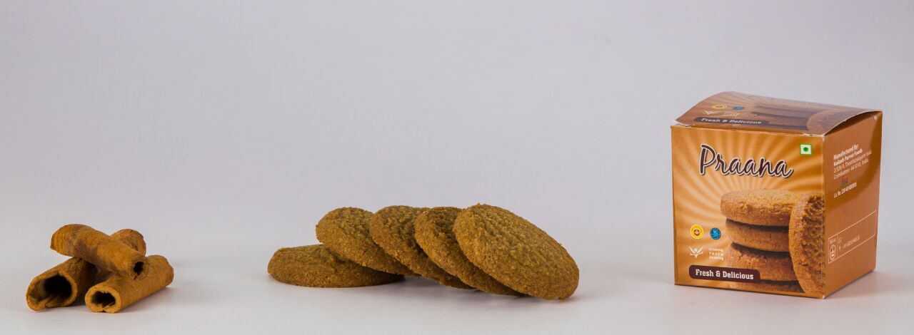
Cinnamon Cookies

Slide 9
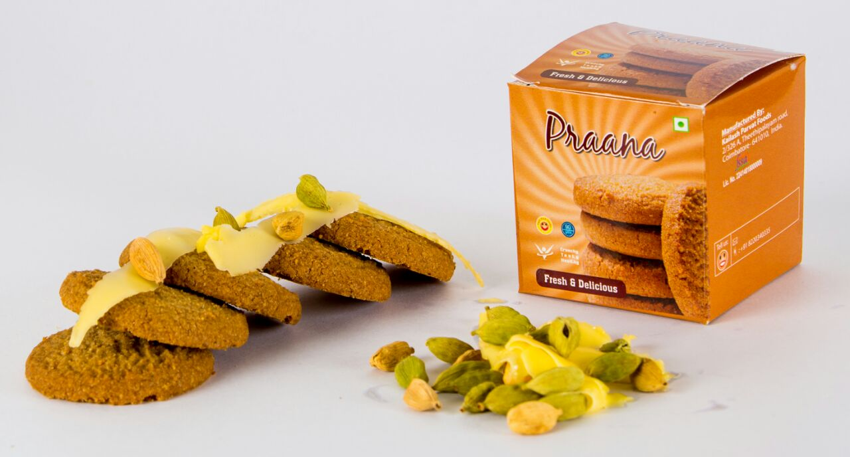
Butter Elaichi Cookies

Slide 10
Taste Points & Unique varieties
Usually health foods it is difficult to make it tasty too! That is why they add artificial Flavours essence etc.
However, our strong R and D team due to their previous decades long experience and talent have made many unique varieties which are 100 % natural - very tasty also.
e.g
- Dates cookies.
- Tulsi cookies.
-Butter Elachi (taste is different from market ones). -Neem Honey.

Slide 11
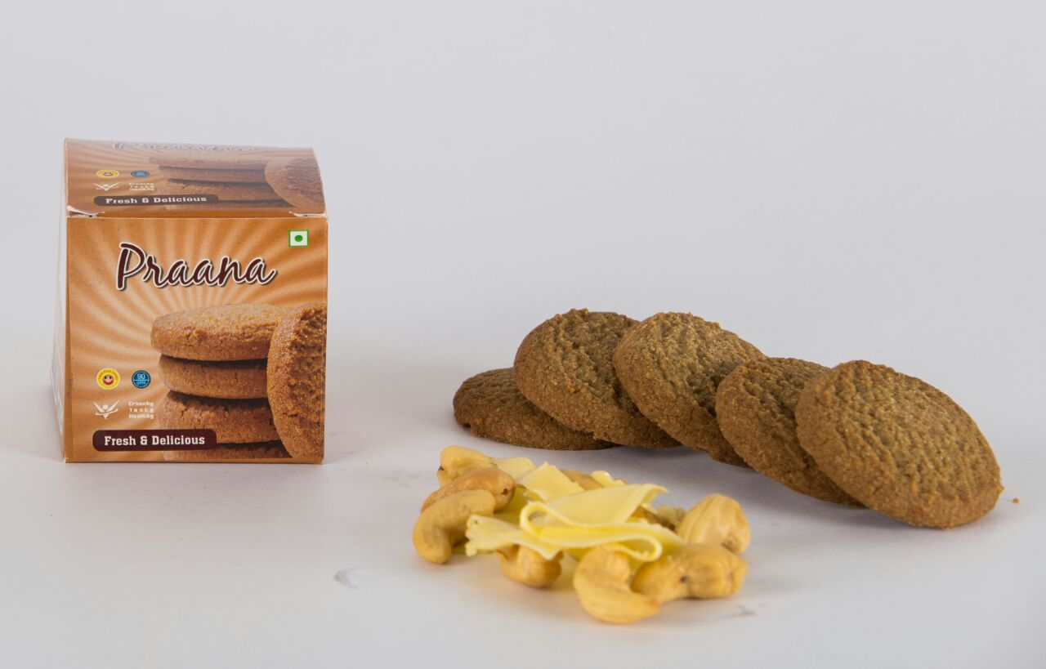
Butter Cashew Cookies

Slide 12
Apart from the retail division, the private label division of the company caters to a wide range of clients that include Hotels, Coffee chains, Restaurants and Airline division etc. Besides this we also cater to a host of companies which procure cookies from us for their internal staff consumption.

Slide 13
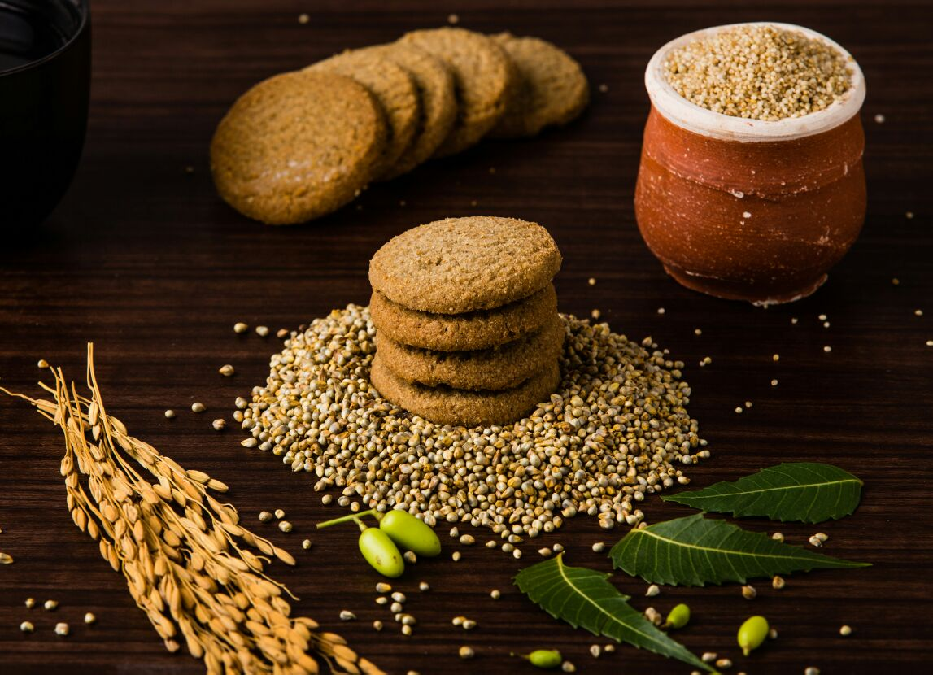
“We bring healthy, tasty & nutrition to your place “

Slide 14
Thank You
For Enquiry & Order Contact:
Name : Mufaiz Basha.C basha@kailashparvatfoods.com
+91-9940-444-698

